Slide 1
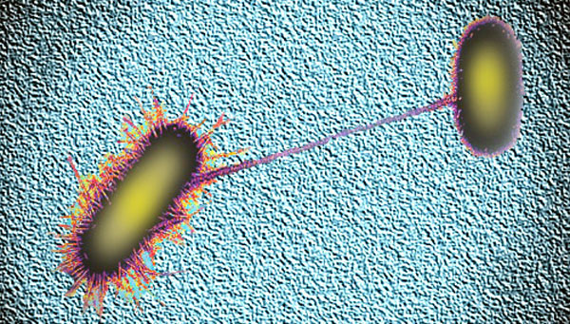
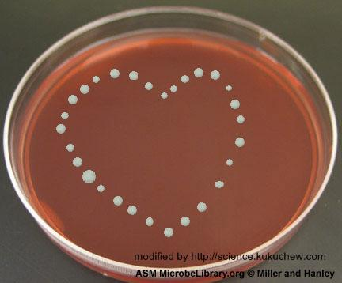
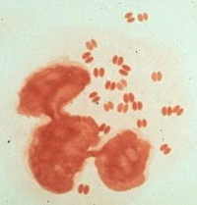
Antimicrobial PK/PD
Jason C. Gallagher, Pharm.D., FCCP, BCPS

Slide 2
Objectives
After the lecture and readings, the student should be able to:
Describe the impact of PK/PD parameters in the choice of antimicrobial therapy
Explain the rational dosing of antibiotics based on pharmacodynamic parameters
Choose an optimal antimicrobial agent for a given patient based on relevant PK/PD parameters

Slide 3
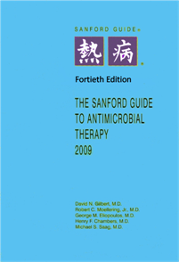
What’s the Point of this Lecture?
Mr. Z is admitted to the ICU with suspected nosocomial pneumonia. The intern writing the orders turns to you and asks “Sanford says ceftazidime 1-2g q8-12h. Which is the best regimen?”
Ceftazidime 2g q12h
Ceftazidime 1g q8h
Ceftazidime 1g q12h
Ceftazidime 2g q8h
Renal Function
Organism
Illness Severity
Site of Infection
Pharmacokinetics/Pharmacodynamics

Slide 4
Relationships – Most Diseases
Drug
Patient
Pharmacodynamics
Pharmacokinetics

Slide 5
Relationships in the Infected Patient
Pathogen
Resistance mechanisms
Infection
Pharmacodynamics
Immune response
Drug
Patient
Pharmacodynamics (toxicity)
Pharmacokinetics

Slide 6
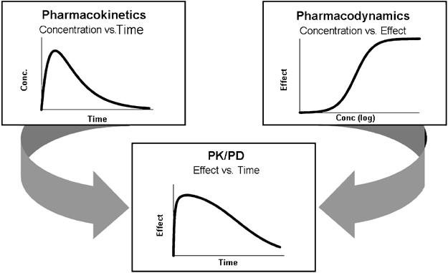
PK/PD
www.nature.com

Slide 7
MIC testing
Susceptibility determined by MIC values and achievable in vivo concentrations
Low MIC values indicate potency, BUT pharmacokinetics and pharmacodynamics (PK/PD) must be considered
Low MIC values will not matter if the drug does not reach those concentrations at the site of infection

Slide 8
MIC testing
An isolate of Pseudomonas aeruginosa is recovered from the sputum of a patient with pneumonia. The susceptibility report is:
Drug | MIC | Susceptibility
Aztreonam | 128 | R
Imipenem | 8 | I
Levofloxacin | 32 | R
Piperacillin | 8 | S
Tobramycin | 4 | S
Notes:
if CNS, choose pip b/c it goes in brain. Tobra does not

Slide 9
Susceptibility Testing We still need to think!
An urinary isolate of E.coli is collected from a male patient with a UTI and possible prostatitis.
Allergies: Sulfonamides (rash)
Drug | Value
Amoxicillin | S
Ciprofloxacin | S
Moxifloxacin | S
Nitrofurantoin | S
TMP/SMX | S
Notes:
No SMX b/c allergy
No Nitrofurantoin is no good b/c not prostate
No Moxi is liver
Maybe Amox
YES cipro b/c goes in prostate

Slide 10
Pharmacokinetics Absorption
Is drug orally absorbed? If so, is oral absorption desirable for the infection being treated?
Vancomycin and C. difficile
Aminoglycosides
Systemic infections
Pre-op for GI surgery
Fluoroquinolones

Slide 11
Pharmacokinetics Absorption
Types of IV -> oral switches
Equivalent
Parallel
Stepdown
Watch your patient characteristics

Slide 12
Pharmacokinetics Distribution
Tissue penetration
Good – urine, kidney, soft tissues
Bad – prostate, eye, abscess, vegetation
Variable – CNS
Patient factors
Poor circulation
Altered volumes of distribution
Obesity
Abscess should to be drained b/c no drug will go in
Notes:
Abscess has to be drained b/c no drug will go in

Slide 13
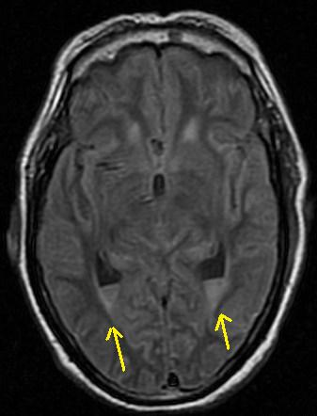
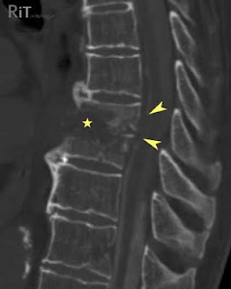
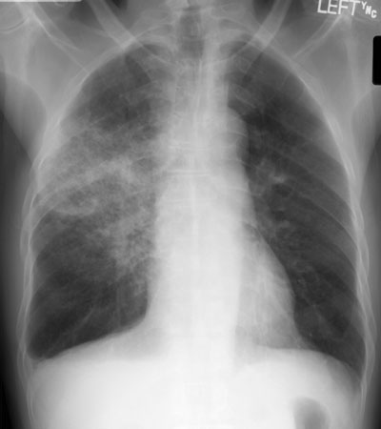
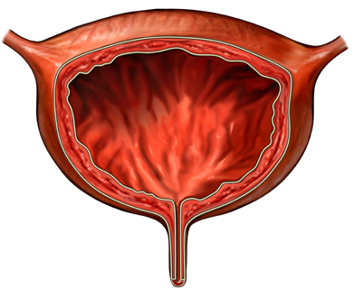
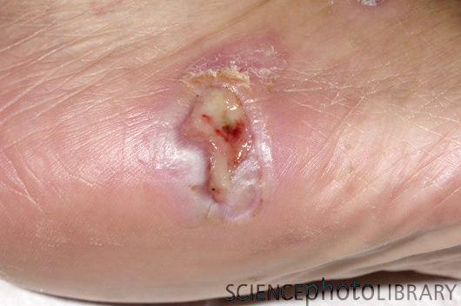
Distribution Matters
Klebseilla pneumoniae infection of the:
Susceptible to:
Ceftriaxone
Imipenem/cilastatin
Moxifloxacin
Piperacillin/tazobactam
Tobramycin
Notes:
UTI: NO moxi
Brain: Yes ceftriaxone, yes moxi
Vertebre: NO tobra

Slide 14
Pharmacokinetics Metabolism
Hepatic disease
Can influence antibiotic choice
Examples: rifampin, caspofungin (antifungal)
Relatively few antibiotics are problematic in liver failure
Drug interactions
Mostly occur through cytochrome P450 induction/inhibition
As a class, antibacterial antibiotics have relatively few metabolic drug interactions
Many antifungals affect CYP450
DIs can occur due to overlapping toxicity

Slide 15
Pharmacokinetics Excretion
How is the antibiotic removed from the body?
Effects of renal dysfunction
Dosing concerns
Nephrotoxicity
Usage issues
Extracorporeal elimination
Effects of hemodialysis
Type of dialysis matters

Slide 16
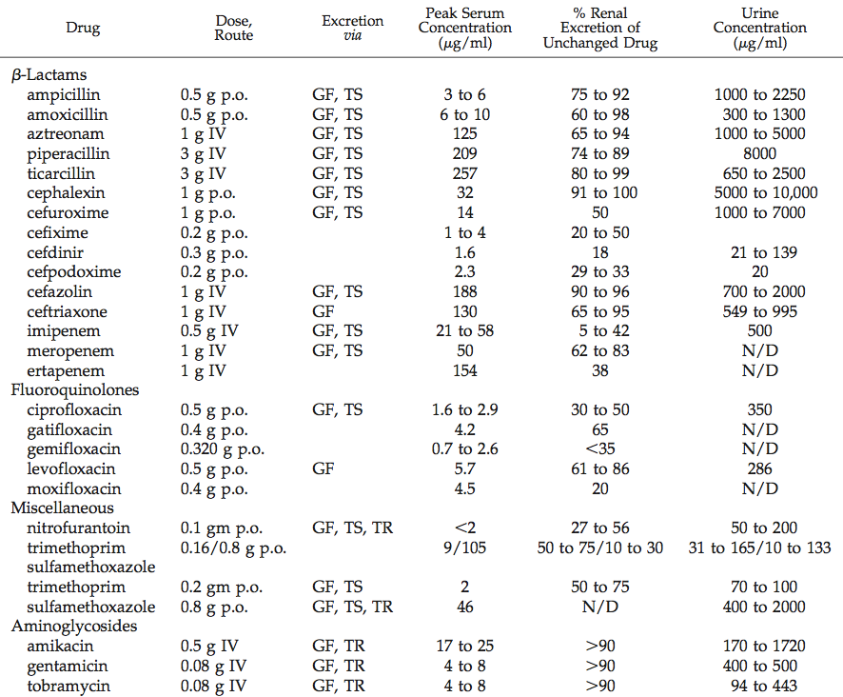
Pharmacokinetics Excretion
Gilbert DN. Clin J Am Soc Nephrol 2006;1:327-31.

Slide 17
Pharmacodynamics Cidal vs. Static
Bacteriostatic – growth is inhibited, but organisms are not killed
Macrolides, tetracyclines, clindamycin, sulfonamides, chloramphenicol, streptogramins
Bactericidal – bacteria are killed
Definition – 3-log kill in 24 hours
Beta-lactams, aminoglycosides, fluoroquinolones, metronidazole, daptomycin,
vancomycin (±)

Slide 18
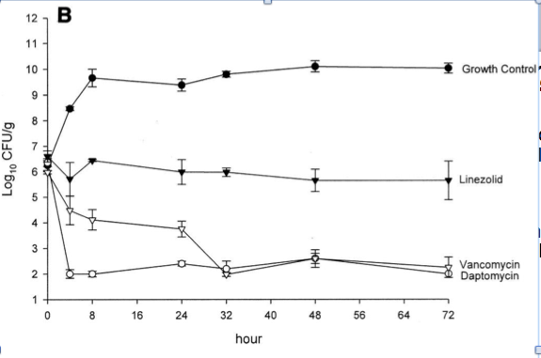
Pharmacodynamics Cidal vs. Static
AAC 2004;48:4665

Slide 19
Pharmacodynamics Cidal vs. Static
Quirks
Antibiotics may have different types of activity for different organisms (e.g. enterococci)
Combinations of static drugs may be cidal
In vitro vs. in vivo effects
Cidal activity preferred in neutropenia, meningitis, endocarditis, and possibly osteomyelitis
Vancomycin

Slide 20
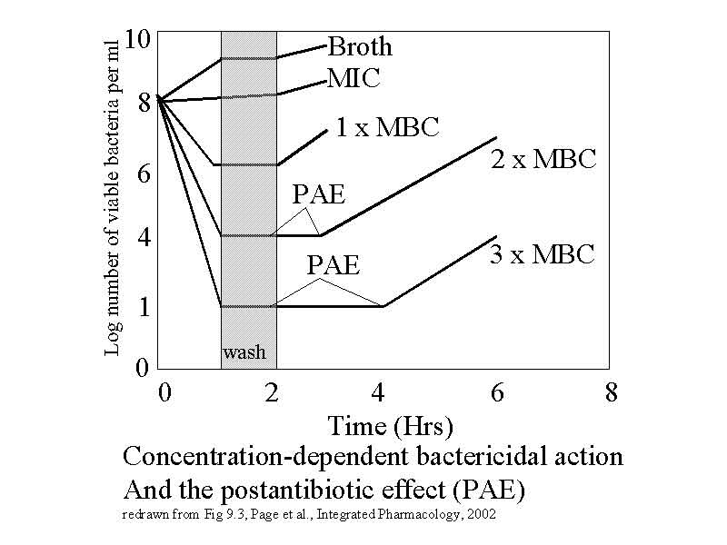
Pharmacodynamics Post-antibiotic Effect (PAE)
Suppression of growth after antibiotic eliminated
Most antibacterials have PAE vs GPCs
Carbapenems, aminoglycosides, fluoroquinolones have PAE vs GNRs

Slide 21
Pharmacodynamics Combination Therapies
Synergy- 2 + 2 = 10
Methods to obtain synergy
Blocking sequential metabolic steps (e.g. TMP/SMX)
Inhibiting enzymatic inactivation (e.g. ampicillin + sulbactam)
Enhancement of antibiotic uptake (e.g. ampicillin + gentamicin)

Slide 22
Pharmacodynamics Combination Therapies
Antagonism 2 + 2 = 1
Methods of antagonism
Static agents inhibiting cidal activity of cell-wall active agents (e.g. tetracycline + amoxicillin)
Induction of enzymatic inactivation (e.g. ceftazidime + piperacillin)

Slide 23
Pharmacodynamics
Parameters predictive of efficacy:
AUC/MIC
Cmax:MIC ratio
Time>MIC
Parameters predictive of safety:
AUC
Cmax
Time>toxic threshold value

Slide 24
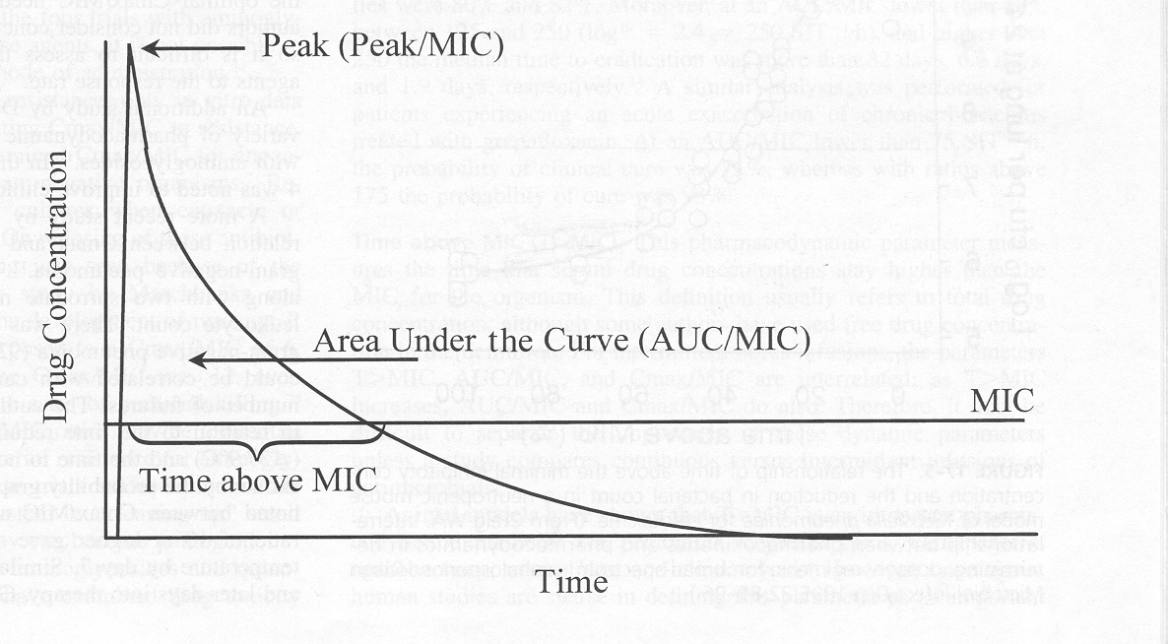
Pharmacodynamics
Mandell GL et al. Mandell, Douglas and Bennett’s Principles and Practice of Infectious Diseases. 4th ed. 1990.

Slide 25
Area Under Curve/MIC Ratio (AUC/MIC)
Drug exposure (AUC) divided by minimum inhibitory concentration of a particular organism (MIC)
AUC | MIC | AUC/MIC
400 | 2 | 200
400 | 4 | 100
600 | 4 | 150
Concentration
AUC
MIC
Time
Notes:
Different from another parameter “AUIC” based on serum inhibitory concentrations…

Slide 26
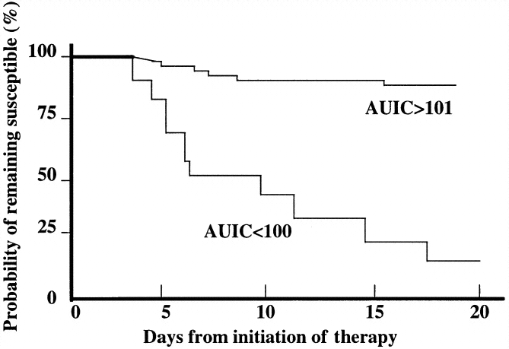
AUC/MIC Ratio
Probability of developing resistance during treatment for nosocomial pneumonia
Thomas, et al. Antimicrob Agents Chemo 1998;42:521-7.

Slide 27
AUC/MIC Ratio – MIC component
Varies by particular isolate of organism
“Same drug, different bug”
Ex. Levofloxacin vs. Pseudomonas
**important is MIC
Levo-sensitive
Levo-resistant
Concentration
AUC=100
MIC=4 mcg/mL
MIC=1 mcg/mL
MIC
AUC/MIC
100/1 = 100
AUC/MIC
100/4 = 25
Time
Notes:
Breakpoint = 2 mcg/mL

Slide 28
AUC/MIC Ratio – Summary
Parameter linking drug exposure to susceptibility
Correlates with clinical outcomes in vivo
Highly sensitive to variations in MIC
Limitations
Presumes serum AUC relates to drug at active site
Difficult to monitor in clinical practice
Role in establishing doses
Notes:
Not going to appear on your PK monitoring sheets…

Slide 29
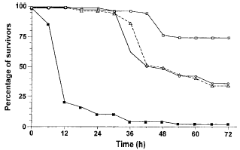
Concentration-dependent Activity
80mg/kg q24h
40mg/kg q12h
20mg/kg q6h
Control
Dose-fractionation experiment with lomefloxacin in an animal model
Same total dose given as different regimens
Lode, et al. Clin Inf Dis 1998;27:33-9

Slide 30
Cmax:MIC ratio
Cmax:MIC ratio >8-12 associated with clinical success
Optimal ratio varies with drug and organism
Concentration
Cmax:MIC
MIC
Time

Slide 31
Pharmacodynamics Concentration- vs. Time-dependence
Concentration-dependent drugs
Level of activity is best predicted by C_{max}:MIC or AUC/MIC
Higher concentrations work better
Ideal administration – infrequent, high doses
Examples: metronidazole, aminoglycosides, fluoroquinolones, daptomycin, ketolides

Slide 32
Concentration-dependent Activity – Summary
Activity is maximized with high concentrations
Limitations
Optimal peaks must have acceptable toxicity
Peaks difficult to monitor
Best in combination with postantibiotic effect to suppress growth of surviving organisms

Slide 33
Time-dependent Killing
Best represented by Time>MIC
Optimal Time>MIC varies
Usually at least 40% of dosing interval
>50% in neutropenia
Concentration
Time>MIC
MIC
Time

Slide 34
Time-dependent Killing
Killing ↑ with ↑ steady-state drug concentration until plateau is reached
Usually 4-5 times MIC
Bacterial Killing
1X
2X
4X
8X
16X
32X
Steady-state Concentration (multiple MIC)

Slide 35
Pharmacodynamics Concentration- vs. Time-dependence
Time-dependent drugs
aka Concentration-independent
Level of activity is dependent on time above MIC
Ideal administration – continuous infusion or frequent, smaller doses
Contribution to increasing concentration maxes out ~4-5 X MIC
Higher concentrations do not work better
Examples: beta-lactams, vancomycin, macrolides, tetracyclines

Slide 36
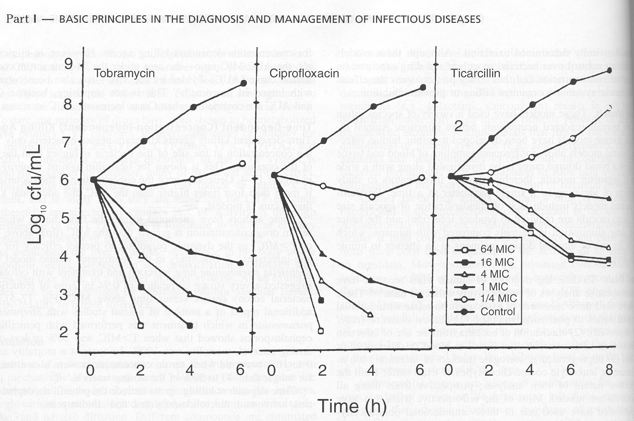
Mandell GL et al. Mandell, Douglas and Bennett’s Principles and Practice of Infectious Diseases. 4th ed. 1990.

Slide 37
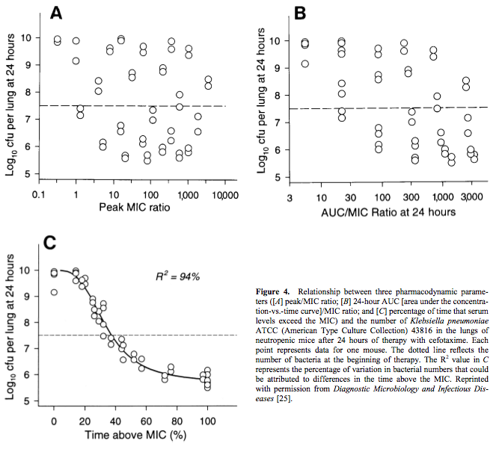
Craig W et al. CID 1998;26:1-12

Slide 38
Pharmacodynamic Parameters of Interest
Drug/Class | Parameter linked to efficacy
 | AUC/MIC | Cmax:MIC | Time>MIC
Penicillins |  |  | √
Cephalosporins |  |  | √
Carbapenems |  |  | √
Aminoglycosides | √ | √
Fluoroquinolones | √ | √
Vancomycin | √
Macrolides |  |  | √
Tetracyclines | √
Adapted from Nightingale CH. Antimicrobial Pharmacodynamics. 2002

Slide 39
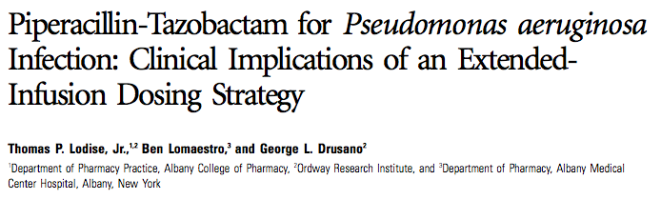
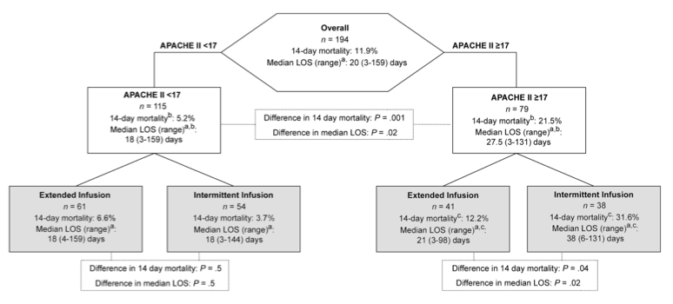
Clinical Application
Lodise TP et al. CID 2007;44:356-63

Slide 40
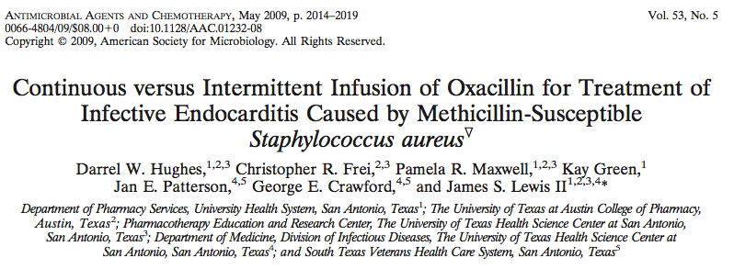
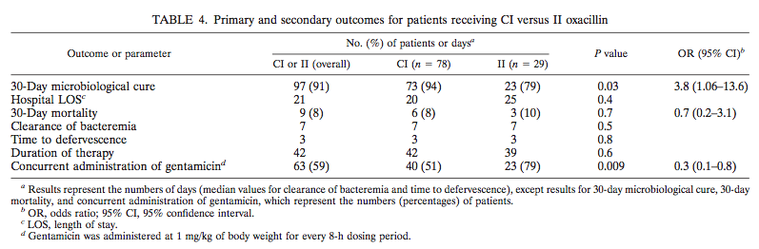
Clinical Application

Slide 41
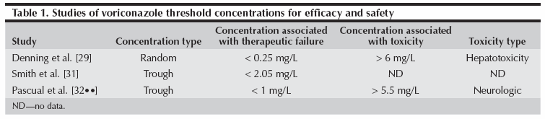
Clinical Application
Voriconazole has high intra- and inter-patient variability
High concentrations associated with toxicity; low concentrations with failure
Gallagher JC. Current Fungal Infection Reports 2009;3:69-76.

Slide 42
Clinical Application
Extended-infusions of beta-lactams
Piperacillin/tazobactam
Cefepime
Ceftazidime
Doripenem
Continuous infusion beta-lactams
Extended interval aminoglycosides
Targeted vancomycin and voriconazole troughs
Aminoglycoside therapeutic drug monitoring
Daptomycin once-daily dosing
Dosing regimens of many classes of antibiotics

Slide 43
Summary
PK and PD principles can be used to rationally select antibiotic doses
PD allows for optimization of antibiotic dosage schedules
PK/PD knowledge can allow you to optimally treat in difficult scenarios

